Slide 1
Rails: API-only Applications { level: "beginner"­­ }
Notes:
Thank everyone for coming out this evening.

Slide 2








About RubyJax+
Notes:
Introduce yourself, John and Josh No time for public introductions; how about a wave?
Briefly introduce RubyJax and Ascentis
RubyJax+ community web devs, mostly ruby. Discuss the plus at then end.
Ascentis, where I work as ruby and sometimes Java. HCM, cool buzzwords for HR, payroll and TMS!
Ascentis.com
Let’s go! Many might know how to create a rails app, maybe not. We’ll discuss an API via rails. Hold Qs

Slide 3



Tonight’s Goal
WHAT
HOW
TOOLS
Notes:
When you leave you’ll know,
- what an API is
- how to create one
- tools that can assist
we’ll step through the five Ws and then get into How.

Slide 4
WHO
Write a blog post?
Have a discussion during an interview?
Give a presentation at RubyJax+?
Notes:
Not calling anyone out but…
Who here feels they know enough about APIs to…
Before we dive in, it’s always useful to have a good understanding.
Time is short, full disclosure:
- more experienced devs: left out things on purpose, but feel free to correct if I misspeak
- less experienced devs: be mindful we are only scratching the surface

Slide 5

WHAT
Application:
something that provides a service
Programming:
a process where an application is used to create something
Interface:
a boundary for communication with an application
Notes:
Wikipedia:
a set of subroutine definitions, protocols, and tools for building application software.
mouthful
In general terms, it is a set of clearly defined methods of communication between various software components.
demystify with a non-technical definition
Consider an outlet. It loosely fits criteria:
Service (electricity), create (coffee machine), boundary (plug shapes and sizes

Slide 6
WHAT cont
an Interface
used by Programs
to interact with an Application
Notes:
If we reverse the terms…

Slide 7
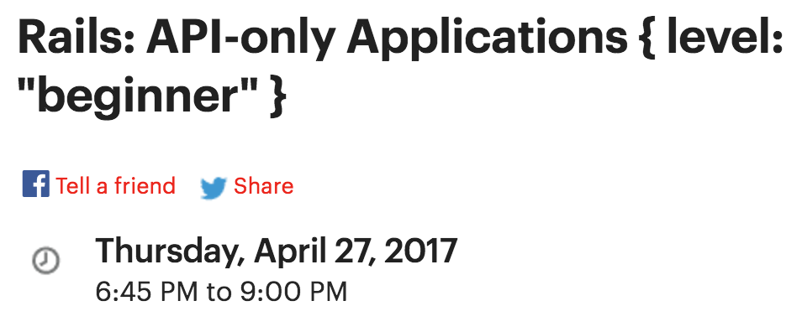
WHAT cont
Notes:
Consider Meetup.com. When you signed up… Facebook & Twitter
Behind the scenes is an interface Meetup uses to interact with Facebook and Twitter. In this case it’s…
Outlet helps us to visualize the idea but with limitations

Slide 8
WHAT cont
APIs aren't designed for human users
APIs have a request-response communication style
APIs are designed to be used in a specific manner
APIs don't care who or what makes the request
APIs hide the details
Notes:
1 – outlet designed for human use (sort of). Software in the past had a similar design. APIs talk with other software
2 – outlet is closer to input/output than actual communication Electricity available or not, cannot ask for more or less.Google suspicious fact is a request, with a response
3 – endpoint, location to direct a request. Will not deliver response if bad request; unlike outlet with a knife
4 – valid is what is important
5 – no knowledge of search method or electricity delivery

Slide 9
WHAT cont
Endpoint:a location to direct a request
Authentication Model: a method to validate a request (think: password)
Request & Response formats: how the request, or response, is formatted
Notes:
Put away our metaphor for now

Slide 10

Questions

Slide 11

WHERE
Notes:
Open IRB
Open link to programmable web

Slide 12
WHEN
This page intentionally left blank.
Notes:
Almost one year ago, Rails 5 released with API mode
Before creating an API required the rails-api gem

Slide 13

WHY
should we use an API?
should we not use an API?
Notes:
Why:
Direct access to information in reusable, secure and manageable manner
Less delivery for a company, more availablity for consumers (talk about watch, strava & myfitnesspal)
Why not:
Primarily when your application isn’t talking to another application, or a developer doesn’t need to direct access to specific information (blog app)

Slide 14
Questions

Slide 15
Initial Step
$ ruby -v
ruby 2.3.0p0
$ rails -v
Rails 5.0.2
gem install rails
rvm install ruby-2.3.1
rails new election_api --api -T -d postgresql
cd election_api/

